Slide 1
ARTIFICIAL INTELLIGENCE
LECTURE-01
Mr. B.VASUNDHARA DEVI
Assistant Professor
Computer Science & Engineering

Slide 2
Artificial Intelligence
In today's world, technology is growing very fast, and we are getting in touch with different new technologies day by day.
Here, one of the booming technologies of computer science is Artificial Intelligence which is ready to create a new revolution in the world by making intelligent machines.
The Artificial Intelligence is now all around us. It is currently working with a variety of subfields, ranging from general to specific, such as self-driving cars, playing chess, proving theorems, playing music, Painting, etc.
AI is one of the fascinating and universal fields of Computer science which has a great scope in future. AI holds a tendency to cause a machine to work as a human.

Slide 3
Artificial Intelligence
Artificial Intelligence is composed of two words Artificial and Intelligence, where Artificial defines "man-made," and intelligence defines "thinking power", hence AI means "a man-made thinking power.“
So, we can define AI as:
"It is a branch of computer science by which we can create intelligent machines which can behave like a human, think like humans, and able to make decisions."
Artificial Intelligence exists when a machine can have human based skills such as learning, reasoning, and solving problems
With Artificial Intelligence you do not need to preprogram a machine to do some work, despite that you can create a machine with programmed algorithms which can work with own intelligence, and that is the awesomeness of AI.

Slide 4
Advantages of Artificial Intelligence
High Accuracy with less errors: AI machines or systems are prone to less errors and high accuracy as it takes decisions as per pre-experience or information.
High-Speed: AI systems can be of very high-speed and fast-decision making, because of that AI systems can beat a chess champion in the Chess game.
High reliability: AI machines are highly reliable and can perform the same action multiple times with high accuracy.

Slide 5
Advantages of Artificial Intelligence
Useful for risky areas: AI machines can be helpful in situations such as defusing a bomb, exploring the ocean floor, where to employ a human can be risky.
Digital Assistant: AI can be very useful to provide digital assistant to the users such as AI technology is currently used by various E-commerce websites to show the products as per customer requirement.
Useful as a public utility: AI can be very useful for public utilities such as a self-driving car which can make our journey safer and hassle-free, facial recognition for security purpose, Natural language processing to communicate with the human in human-language, etc.

Slide 6
Disadvantages of Artificial Intelligence
High Cost: The hardware and software requirement of AI is very costly as it requires lots of maintenance to meet current world requirements.
Can't think out of the box: Even we are making smarter machines with AI, but still they cannot work out of the box, as the robot will only do that work for which they are trained, or programmed.
No feelings and emotions: AI machines can be an outstanding performer, but still it does not have the feeling so it cannot make any kind of emotional attachment with human, and may sometime be harmful for users if the proper care is not taken.

Slide 7
Disadvantages of Artificial Intelligence
Increase dependency on machines: With the increment of technology, people are getting more dependent on devices and hence they are losing their mental capabilities.
No Original Creativity: As humans are so creative and can imagine some new ideas but still AI machines cannot beat this power of human intelligence and cannot be creative and imaginative.

Slide 8
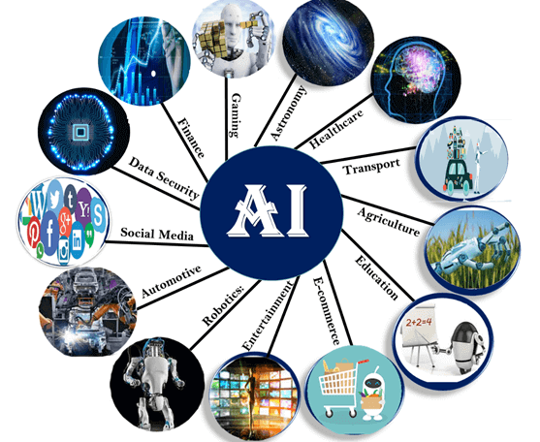
Application of AI

Slide 9
Application of AI
AI in Astronomy Artificial Intelligence can be very useful to solve complex universe problems. AI technology can be helpful for understanding the universe such as how it works, origin, etc.
AI in Healthcare In the last, five to ten years, AI becoming more advantageous for the healthcare industry and going to have a significant impact on this industry.
Healthcare Industries are applying AI to make a better and faster diagnosis than humans. AI can help doctors with diagnoses and can inform when patients are worsening so that medical help can reach to the patient before hospitalization.
AI in Gaming AI can be used for gaming purpose. The AI machines can play strategic games like chess, where the machine needs to think of a large number of possible places.
AI in Finance AI and finance industries are the best matches for each other. The finance industry is implementing automation, Chabot, adaptive intelligence, algorithm trading, and machine learning into financial processes.

Slide 10
Application of AI
AI in Data Security The security of data is crucial for every company and cyber-attacks are growing very rapidly in the digital world. AI can be used to make your data more safe and secure. Some examples such as AEG bot, AI2 Platform, are used to determine software bug and cyber-attacks in a better way.
AI in Social Media Social Media sites such as Facebook, Twitter, and Snapchat contain billions of user profiles, which need to be stored and managed in a very efficient way. AI can organize and manage massive amounts of data. AI can analyze lots of data to identify the latest trends, hashtag, and requirement of different users.
AI in Travel & Transport AI is becoming highly demanding for travel industries. AI is capable of doing various travel related works such as from making travel arrangement to suggesting the hotels, flights, and best routes to the customers. Travel industries are using AI-powered chat bots which can make human-like interaction with customers for better and fast response.

Slide 11
Application of AI
AI in Automotive Industry Some Automotive industries are using AI to provide virtual assistant to their user for better performance. Such as Tesla has introduced TeslaBot, an intelligent virtual assistant. Various Industries are currently working for developing self-driven cars which can make your journey more safe and secure.
AI in Robotics Artificial Intelligence has a remarkable role in Robotics. Usually, general robots are programmed such that they can perform some repetitive task, but with the help of AI, we can create intelligent robots which can perform tasks with their own experiences without pre-programmed. Humanoid Robots are best examples for AI in robotics, recently the intelligent Humanoid robot named as Erica and Sophia has been developed which can talk and behave like humans.

Slide 12
Application of AI
AI in Entertainment We are currently using some AI based applications in our daily life with some entertainment services such as Netflix or Amazon. With the help of ML/AI algorithms, these services show the recommendations for programs or shows.
AI in Agriculture Agriculture is an area which requires various resources, labor, money, and time for best result. Now a day's agriculture is becoming digital, and AI is emerging in this field. Agriculture is applying AI as agriculture robotics, solid and crop monitoring, predictive analysis. AI in agriculture can be very helpful for farmers.
AI in E-commerce AI is providing a competitive edge to the e-commerce industry, and it is becoming more demanding in the e-commerce business. AI is helping shoppers to discover associated products with recommended size, color, or even brand.
AI in education: AI can automate grading so that the tutor can have more time to teach. AI chatbot can communicate with students as a teaching assistant. AI in the future can be work as a personal virtual tutor for students, which will be accessible easily at any time and any place.

Slide 13
AGENT
An agent can be anything that perceive its environment through sensors and act upon that environment through actuators. An Agent runs in the cycle of perceiving, thinking, and acting. An agent can be:
Human-Agent: A human agent has eyes, ears, and other organs which work for sensors and hand, legs, vocal tract work for actuators.
Robotic Agent: A robotic agent can have cameras, infrared range finder, NLP for sensors and various motors for actuators.
Software Agent: Software agent can have keystrokes, file contents as sensory input and act on those inputs and display output on the screen.
Hence the world around us is full of agents such as thermostat, cellphone, camera, and even we are also agents.

Slide 14
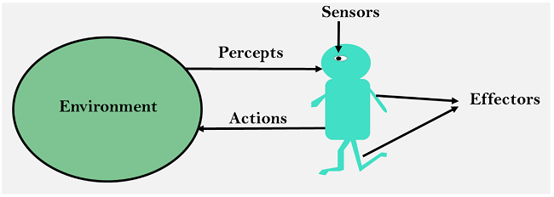
AGENT
Sensor: Sensor is a device which detects the change in the environment and sends the information to other electronic devices. An agent observes its environment through sensors.
Actuators: Actuators are the component of machines that converts energy into motion. The actuators are only responsible for moving and controlling a system. An actuator can be an electric motor, gears, rails, etc.
Effectors: Effectors are the devices which affect the environment. Effectors can be legs, wheels, arms, fingers, wings, fins, and display screen.

Slide 15
Intelligent Agent
An intelligent agent is an autonomous entity which act upon an environment using sensors and actuators for achieving goals. An intelligent agent may learn from the environment to achieve their goals. A thermostat is an example of an intelligent agent.
Following are the main four rules for an AI agent:
Rule 1: An AI agent must have the ability to perceive the environment.
Rule 2: The observation must be used to make decisions.
Rule 3: Decision should result in an action.
Rule 4: The action taken by an AI agent must be a rational action.

Slide 16
Rational Agent
A rational agent is an agent which has clear preference, models uncertainty, and acts in a way to maximize its performance measure with all possible actions.
A rational agent is said to perform the right things. AI is about creating rational agents to use for game theory and decision theory for various real-world scenarios.
For an AI agent, the rational action is most important because in AI reinforcement learning algorithm, for each best possible action, agent gets the positive reward and for each wrong action, an agent gets a negative reward.

Slide 17
Structure of an AI Agent
The task of AI is to design an agent program which implements the agent function. The structure of an intelligent agent is a combination of architecture and agent program. It can be viewed as:
Agent = Architecture + Agent program
Following are the main three terms involved in the structure of an
AI agent:
Architecture: Architecture is machinery that an AI agent executes on.
Agent Function: Agent function is used to map a percept to an action.
Agent program: Agent program is an implementation of agent function. An agent program executes on the physical architecture to produce function .

Slide 18
PEAS Representation
PEAS is a type of model on which an AI agent works upon. When we define an AI agent or rational agent, then we can group its properties under PEAS representation model. It is made up of four words:
P: Performance measure
E: Environment
A: Actuators
S: Sensors

Slide 19
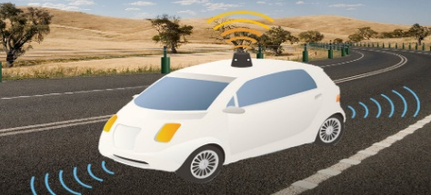
PEAS for self-driving cars

Slide 20
Self-driving cars
Let's suppose a self-driving car then PEAS representation will be:
Performance: Safety, time, legal drive, comfort
Environment: Roads, other vehicles, road signs
Actuators: Steering, accelerator, brake, signal, horn
Sensors: Camera, GPS, speedometer, odometer, accelerometer, sonar.

Slide 21
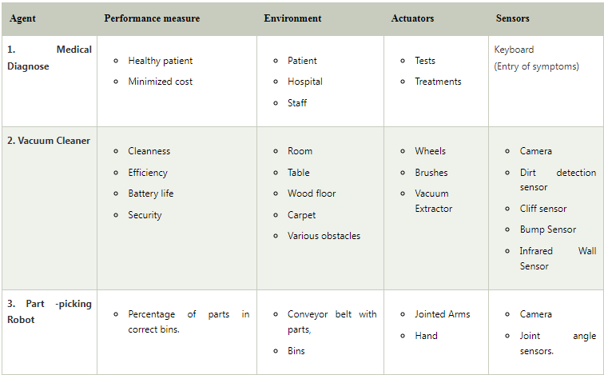
Example of Agents with their PEAS representation

Slide 22
Search Algorithms in Artificial Intelligence
Problem-solving agents:
In Artificial Intelligence, Search techniques are universal problem-solving methods. Rational agents or Problem-solving agents in AI mostly used these search strategies or algorithms to solve a specific problem and provide the best result.
Problem-solving agents are the goal-based agents and use atomic representation. In this topic, we will learn various problem-solving search algorithms.

Slide 23
Search Algorithms in Artificial Intelligence
Search Algorithm Terminologies
Search: Searching is a step by step procedure to solve a search-problem in a given search space. A search problem can have three main factors:
Search Space: Search space represents a set of possible solutions, which a system may have.
Start State: It is a state from where agent begins the search.
Goal test: It is a function which observe the current state and returns whether the goal state is achieved or not.
Search tree: A tree representation of search problem is called Search tree. The root of the search tree is the root node which is corresponding to the initial state.

Slide 24
Search Algorithms in Artificial Intelligence
Actions: It gives the description of all the available actions to the agent.
Transition model: A description of what each action do, can be represented as a transition model.
Path Cost: It is a function which assigns a numeric cost to each path.
Solution: It is an action sequence which leads from the start node to the goal node.
Optimal Solution: If a solution has the lowest cost among all solutions.

Slide 25
Properties of Search Algorithms
Completeness: A search algorithm is said to be complete if it guarantees to return a solution if at least any solution exists for any random input.
Optimality: If a solution found for an algorithm is guaranteed to be the best solution (lowest path cost) among all other solutions, then such a solution for is said to be an optimal solution.
Time Complexity: Time complexity is a measure of time for an algorithm to complete its task.
Space Complexity: It is the maximum storage space required at any point during the search, as the complexity of the problem.

Slide 26
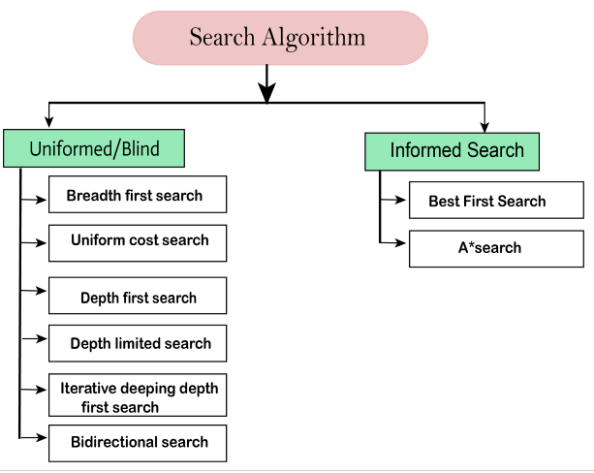
Types of search algorithms
Based on the search problems we can classify the search algorithms into uninformed (Blind search) search and informed search (Heuristic search) algorithms.

Slide 27
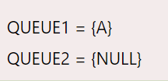
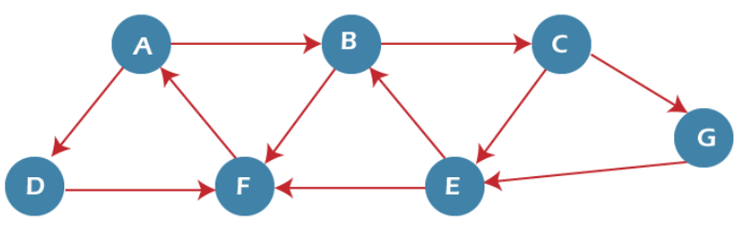

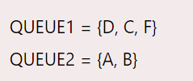
Example of BFS algorithm

Slide 28

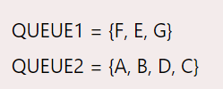
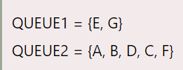
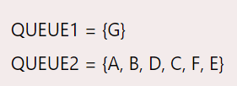
Example of BFS algorithm
Result: ABDCFEG

Slide 29
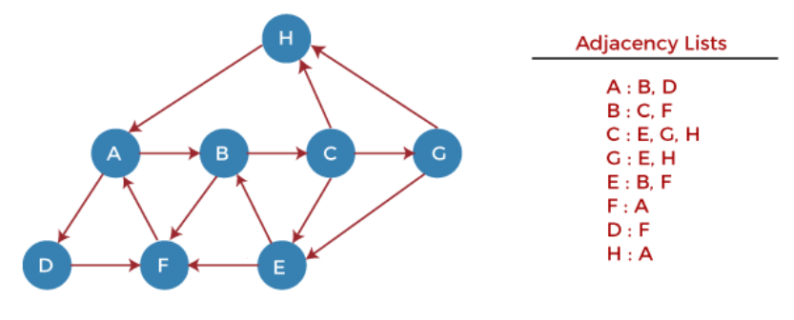
DFS (Depth First Search) algorithm
Step 1 -.
STACK: H
Step 2 -
1.Print: H
STACK: A
Step 3 -
Print: A
STACK: B, D
Step 4 -
Print: D
STACK: B, F
Step 5 -
Print: F
STACK: B

Slide 30
DFS (Depth First Search) algorithm
Step 6 -
Print: B
STACK: C
Step 7 -
Print: C
STACK: E, G
Step 8 -
Print: G
STACK: E
Step 9 -
Print: E
STACK:
Output: HADFBCGE

Slide 31
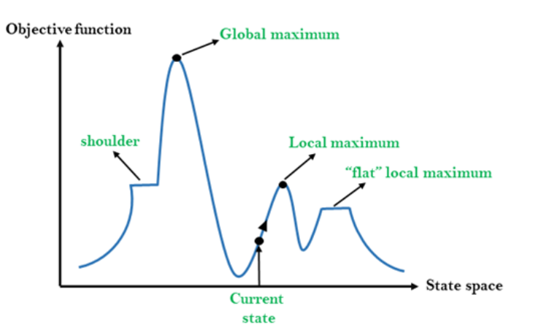
Hill Climbing Algorithm
Hill climbing algorithm is a local search algorithm which continuously moves in the direction of increasing elevation/value to find the peak of the mountain or best solution to the problem. It terminates when it reaches a peak value where no neighbor has a higher value.

Slide 32
Features of Hill Climbing:
Generate and Test variant: Hill Climbing is the variant of Generate and Test method. The Generate and Test method produce feedback which helps to decide which direction to move in the search space.
Greedy approach: Hill-climbing algorithm search moves in the direction which optimizes the cost.
No backtracking: It does not backtrack the search space, as it does not remember the previous states.

Slide 33
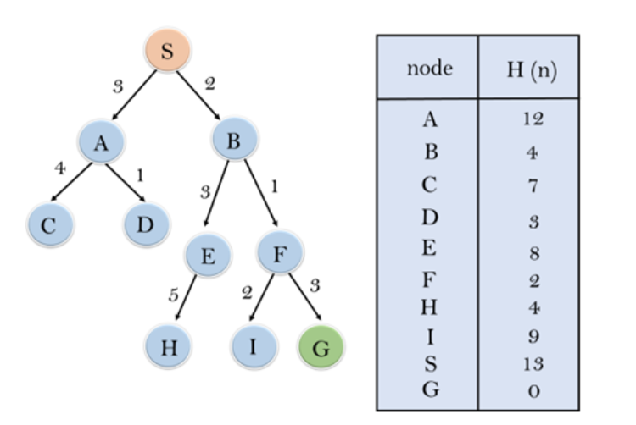
Best-first Search Algorithm
Initialization: Open [A, B], Closed [S]
Iteration 1: Open [A], Closed [S, B]
Iteration 2: Open [E, F, A], Closed [S, B] : Open [E, A], Closed [S, B, F]
Iteration 3: Open [I, G, E, A], Closed [S, B, F] : Open [I, E, A], Closed [S, B, F, G]
Hence the final solution path will be:
S----> B----->F----> G

Slide 34
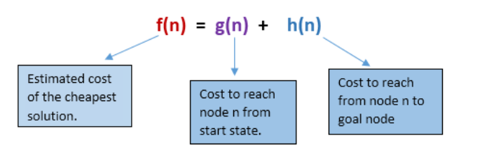
A* Search Algorithm
A* search is the most commonly known form of best-first search. It uses heuristic function h(n), and cost to reach the node n from the start state g(n). It has combined features of UCS and greedy best-first search, by which it solve the problem efficiently. A* search algorithm finds the shortest path through the search space using the heuristic function. This search algorithm expands less search tree and provides optimal result faster. A* algorithm is similar to UCS except that it uses g(n)+h(n) instead of g(n).

Slide 35
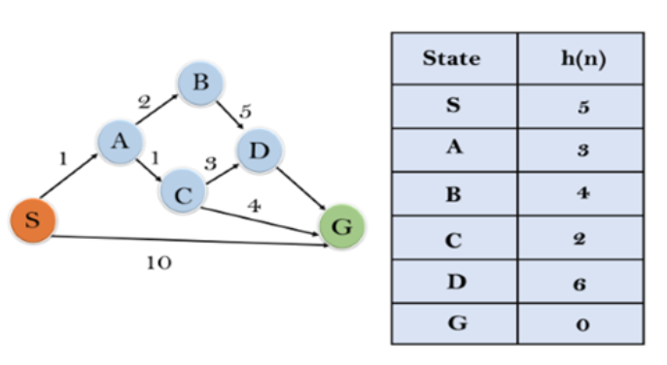
A* Search Algorithm
Initialization: {(S, 5)}
Iteration1: {(S--> A, 4), (S-->G, 10)}
Iteration2: {(S--> A-->C, 4), (S--> A-->B, 7), (S-->G, 10)}
Iteration3: {(S--> A-->C--->G, 6), (S--> A-->C--->D, 11), (S--> A-->B, 7), (S-->G, 10)}
Iteration 4 will give the final result, as S--->A--->C--->G it provides the optimal path with cost 6.

Slide 36
UNIT-1 End Thank you

